Slide 1

Department of Computer Science and Engineering
Event Attendence and Ticketing data Pipeline
Batch Members: Nekkanti Nandini -232003459 Pamula Prajwal - 2320030110 A Abhiram - 2320030077 | Domain Data Engineering Under the Guidance of Dr. N. Shirisha, Assoc.Prof.

Slide 2

Abstract
A lightweight system to create events, manage tickets, and track real-time ticket sales.
Backend built using Node.js + Express to handle event creation, ticket purchase, and metrics generation.
Frontend created with HTML + JavaScript, allowing users to easily add events and buy tickets.
Provides a /metrics API endpoint to monitor total events and total tickets sold.
Stores all data in-memory, so no database is required.
Demonstrates a simple and complete data pipeline:
User → Frontend → API → Backend Processing → Metrics Output.
Easy to run on any system and suitable for learning APIs, web development, and monitoring concepts.

Slide 3
Introduction
This project is about managing events and tickets.
Users can create events and buy tickets.
The backend (Node.js) handles all event and ticket data.
The frontend (HTML + JavaScript) lets users see and use the system easily.
A special metrics page shows how many events are created and how many tickets are sold.
The system stores everything in memory, so no database is needed.
It is easy to run and helps understand how a basic web application works.

Slide 4
Literature Survey
  Full-scale Online Event Ticketing System
  The Design and Architecture
  ZS Guo, 2002
Proposes a scalable online ticketing architecture for large events.
Designed to support many events, multiple providers, and different ticketing agents.
System is divided into modular parts like event management, payment handling, and ticket distribution.
Focuses on scalability so the system can handle high user load.
Highlights the need for a clear separation between components to improve performance.
Useful for understanding how a small in-memory system can grow into a full enterprise solution.

Slide 5
Objectives
To create a simple system for adding and managing events.
To allow users to buy tickets and update ticket counts in real time.
To build a lightweight backend using Node.js and Express for handling event and ticket data.
To design an easy-to-use frontend using HTML and JavaScript.
To provide a /metrics endpoint for tracking total events and total tickets sold.
To demonstrate a complete data flow: event creation → ticket purchase → metrics monitoring.
To store data in memory for quick access without using a database.
To help students understand basic API handling, frontend-backend communication, and monitoring concepts.

Slide 6
Problem Statement
Managing events and tracking ticket sales manually is time-consuming and prone to errors.
Existing systems are often complex, require databases, or need heavy setups.
There is a need for a simple and lightweight system that can quickly create events and monitor ticket usage.
Users should be able to purchase tickets easily and see real-time updates in ticket availability.
A centralized way to monitor event metrics (total events, tickets sold) is required for better visibility.
The system should demonstrate how event data flows through a backend pipeline without requiring a full database.

Slide 7
Existing System
Many small applications still manage events and tickets manually using sheets or basic forms.
Manual systems make it hard to track ticket availability and sales accurately.
Traditional online ticketing systems are complex and require databases, making them hard to set up.
Lightweight systems available today often lack real-time ticket updates.
Users cannot easily see metrics like total events or total tickets sold.
Existing simple tools do not clearly show the flow of data from event creation to ticket purchase.
Overall, current solutions are either too basic or too complex for beginners and learning purposes.

Slide 8
Proposed System
A lightweight event management system that allows users to create events easily.
Tickets can be purchased with a single click, and the sold count updates instantly.
Backend built using Node.js + Express to handle all event and ticket operations.
Frontend created with HTML + JavaScript for simple and user-friendly interaction.
A /metrics endpoint provides real-time information like total events and total tickets sold.
All data is stored in-memory, removing the need for databases and making the system easy to run anywhere.
The system shows a clear data flow from event creation → ticket purchase → metrics monitoring.
Designed to be fast, simple, and suitable for students learning APIs, web development, and data pipelines.

Slide 9
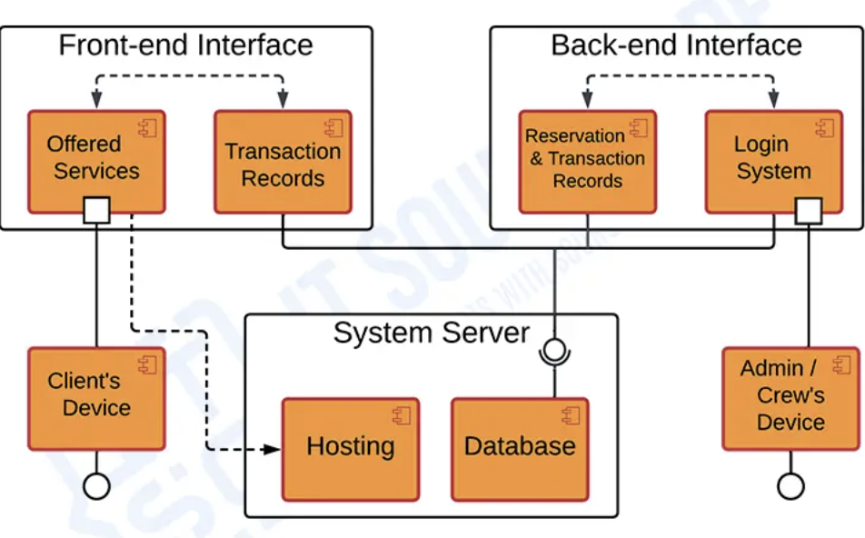
Block Diagram of Proposed System

Slide 10
List of Modules
Import required packages
Set up Express server
Store events in memory
Create events API
Buy ticket API
List events API
Create metrics endpoint
Build simple frontend
Show events on screen
Update ticket count
Display metrics live
Test APIs and frontend

Slide 11
Details about the tools to be used for the project implementation
This project requires Node.js, Express.js, HTML, CSS, JavaScript, Fetch API, and in-memory data handling for event and ticket management.
Docker (optional) can be used for containerizing both frontend and backend services.
Python Simple HTTP Server – is used for running the frontend easily in a browser.

Slide 12
Module Explanation
Event Creation Module: Allows users to create new events by sending event details to the backend. Ticket Purchase Module: Lets users buy tickets and updates the sold count instantly. Event Display Module: Fetches and shows all events along with ticket details on the screen. Backend API Module: Handles all API requests and manages event and ticket logic using Node.js. In-Memory Storage Module: Stores all event data temporarily without using any database. Metrics Monitoring Module: Provides system metrics like total events and tickets sold through /metrics. Frontend UI Module: Displays the interface where users can create events and buy tickets easily. Docker Deployment Module (Optional): Allows running the backend and frontend in containers for easy deployment.

Slide 13
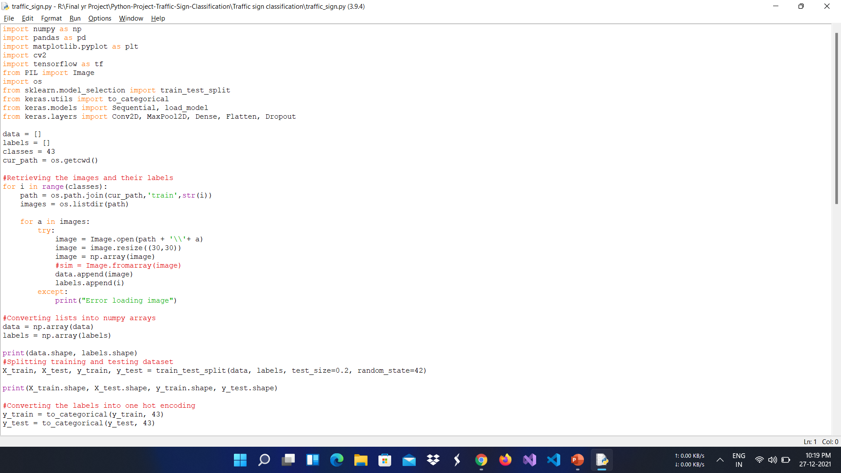
Module Implementation and Result

Slide 14
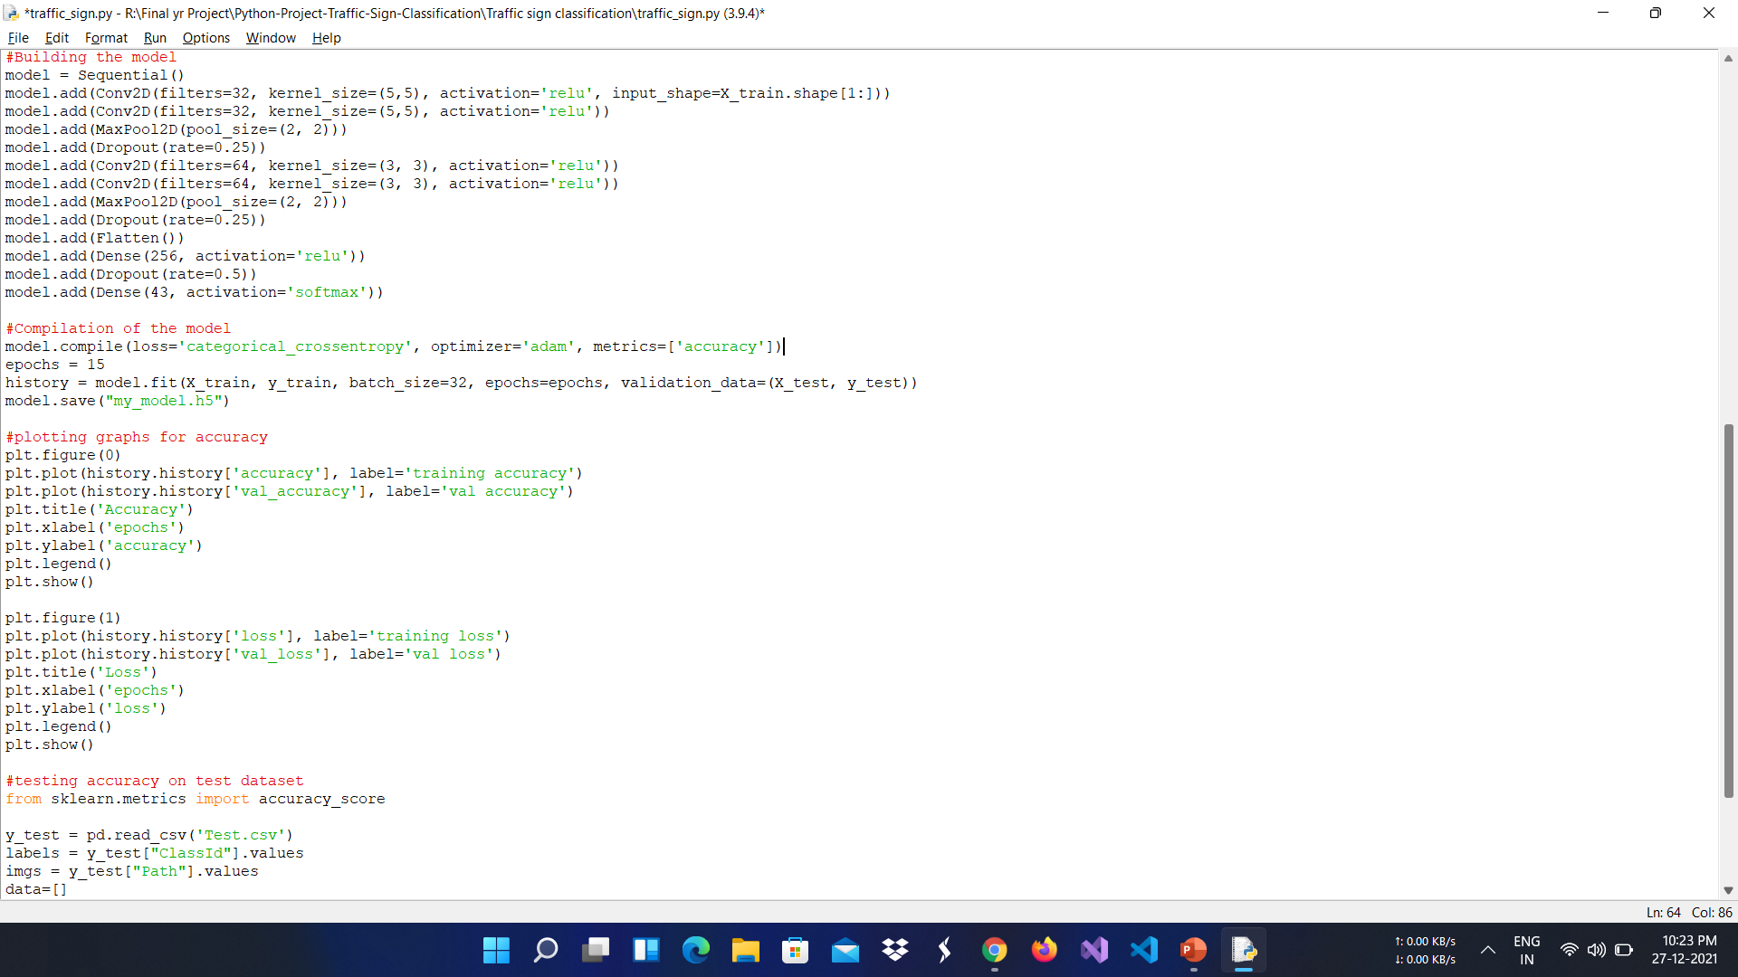

Slide 15
Expected Outcomes
Users can create events easily.
Ticket counts update correctly when tickets are bought.
All events are shown clearly on the screen.
Metrics show total events and total tickets sold.
The system works smoothly without a database.
Frontend and backend communicate successfully.

Slide 16
References
Event Ticketing System Design and Architecture, Z.S. Guo, 2002, University of Macau
Online Events Ticketing Management System – Case Study of a Stadium, ResearchGate, 2023
Building a Scalable Real-Time Ticket Queue System, BookMyShow Engineering Blog, 2025
Real-Time Web Application Design Using Node.js and WebSockets, ResearchGate, 2020
Get Prometheus Metrics from an Express.js App, Medium Technical Article, 2021
Understanding Node.js Event-Driven Architecture, Node.js Community Docs, 2022
Docker Containerization for Web Applications, Docker Documentation, 2023

Slide 17
  Thank You
Notes:
nhghggffghh

